Slide 1
Introduction to Data Mining:
Challenge 1
Muhammad Sumair 22995

Slide 2
Journey
Firstly, I reviewed the data set and checked all the different variables.
After checking all the data, I applied all the data pre-processing techniques.
Since there were no missing values, I did not used missing value filter.
Moreover, there was no use for applying low variance filter and and correlation as well because the data was already pre-processed.
Although, there was a need to filter out some columns so I used column filter for that.

Slide 3
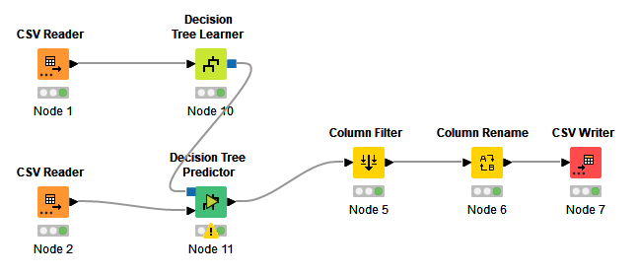
Decision Tree
Greatest accuracy that I achieved by applying decision tree was 0.72660.
Initially, I used the default decision tree and I achieved the accuracy of 0.67075(gain ratio) but then I used normal class distribution and applied the decision tree on gini index.
It performed similar to naive bayes in some case but not better than any one of the other models.

Slide 4
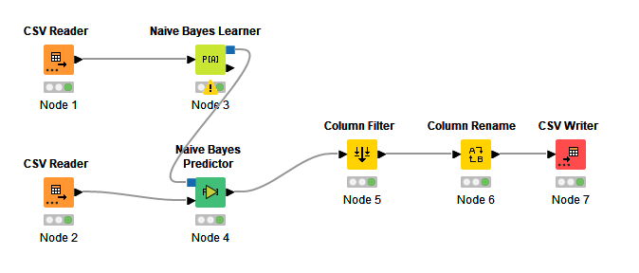
Naive Bayes
The highest accuracy I achieved with this model was 0.72732.
Initially I achieved 0.5
I then increased the minimum standard deviation and the threshold of standard deviation which caused my accuracy to increase to the highest.
It performed similar and even poorer than decision tree in some cases and not better than any other model.

Slide 5
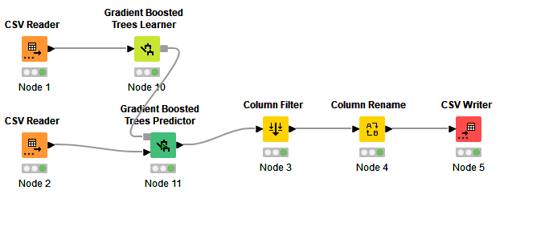
Gradient Boosted
Tree
The highest accuracy I achieved with this model was 0.92502.
Initially, I achieved 0.90153 accuracy with 500 models without any limit of tree depth and with appended individual class probabilities.
When I increased the number of models to 800 and put the seeds to negative number, my accuracy increased.
Gradient Boosted Tree was better than Naive Bayes, Decision Tree and Random Forest. Although I achieved greater accuracy in gradient boosted than stacking but I think that by stacking I could have achieved much greater accuracy if I could have increased number of models to a greater level.

Slide 6
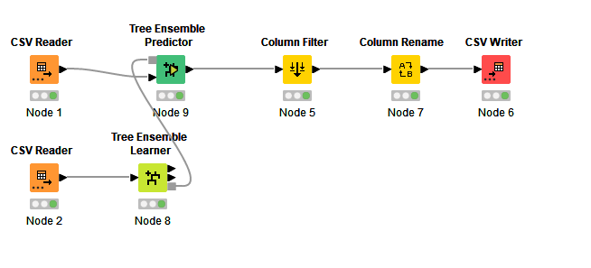
Tree Ensemble
Highest accuracy I achieved with this model is 0.92873.
The accuracy in this model ranged from 0.90100 till the highest value which I achieved.
The accuracy tend to increased with greater number of models and without replacement using information gain with negative seeds.
Although this model made me achieve my personal best accuracy with 870 models.
Accuracy was lower when the models were over 1000 than what I saw in models between 800-900.
This model was the best in terms of accuracy between all the other models.

Slide 7
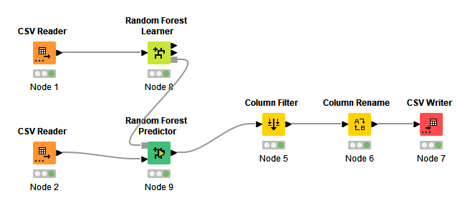
Random Forest
Greatest accuracy I achieved with this model was 0.92783
In the starting stage random forest gave accuracy over 0.9000 with default settings and when the models were increased it started to get better.
The accuracy was greater using gini index and negative seeds and models over 1000.
I used 1200 models to achieve this.
This model was better than decision tree, naïve bayes, stacking and similar to gradient boosted tree.

Slide 8
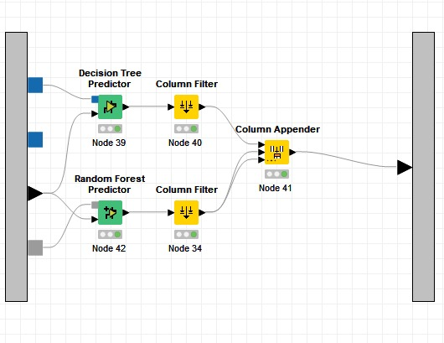
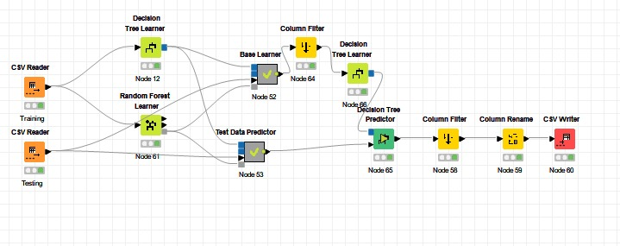
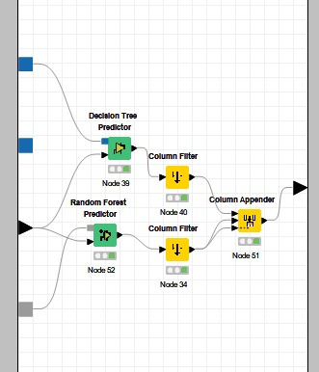
Stacking

Slide 9
Stacking continued
I used decision tree and random forest together in stacking.
Greatest accuracy I achieved was 0.90626 with 800 models and negative seeds.
The range of accuracy was between 0.8000 and the highest I achieved with this model.
I tried different models in stacking but the best accuracy I got was with decision tree and random forest..
I think that maybe I could have gotten a little better accuracy if I would have used three models together but my PC was not supportive enough, although I tried using the three models but the accuracy was around 0.8
I used decision tree as the meta classifier

Slide 10
Winner
The best and the most suitable model according to my accuracy was Tree ensemble through which I achieved 0.92873. Hence Tree ensemble is the winner for me.
The configurations I used are the following:
870 models
Negative Seeds
Without Replacement
Information Gain

